Slide 1
HYPERSPECTRAL INVERSE SKINNING
Team- 21 Arpan Verma, Harshit Gupta 2022105, 2022209

Slide 2

Abstract
The inverse linear blend skinning (LBS) method takes animation poses and works backwards to find the correct skinning weights and transformation matrices that match the original input
By viewing this as a geometric challenge in high-dimensional space, vertex transformations across poses become points, and the problem becomes finding a tight-fitting simplex around these points.
We solve this through a "closest flat" optimization, which achieves state-of-the-art results for both reconstruction accuracy and animation compression.

Slide 3
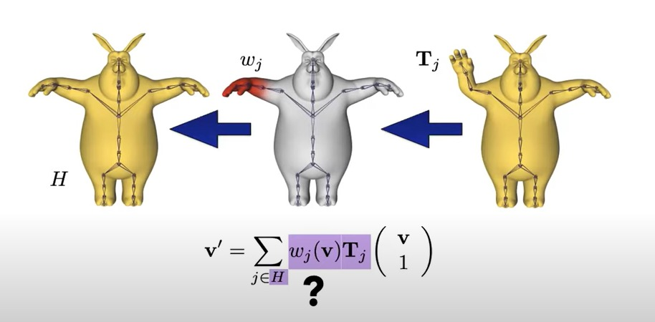

Slide 4
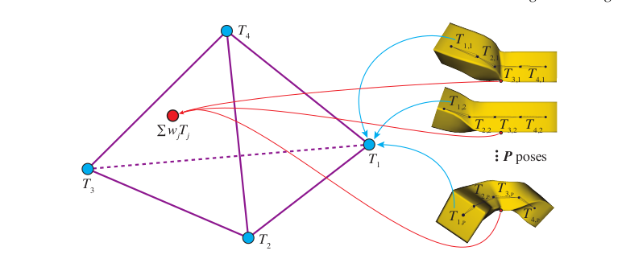

Slide 5
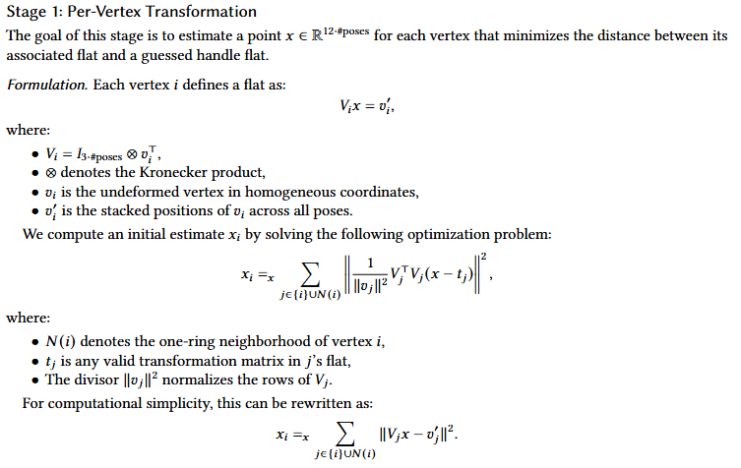

Slide 6

Initial Guess for Flat:
We get the initial guess for the flat from the following equation:

Slide 7
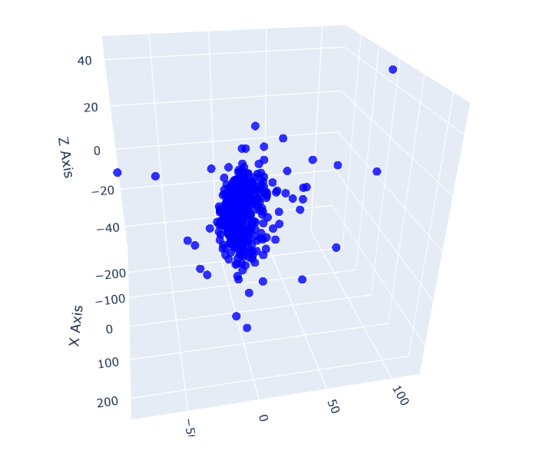

Slide 8

Flat Optimization
We try to minimize the sum of squared flat distanced given an inititual gas.Initially we will take F as my initial guess and then try to minimize the distance by alternately solving wi and F
The Flats did converge and did provide,

Slide 9
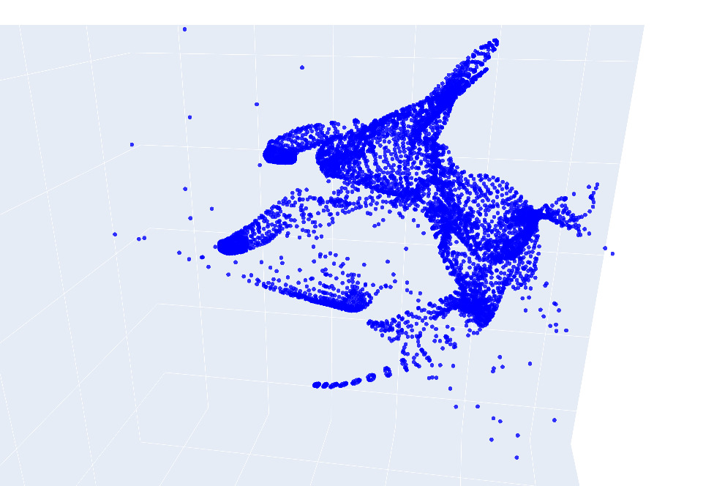

Slide 10
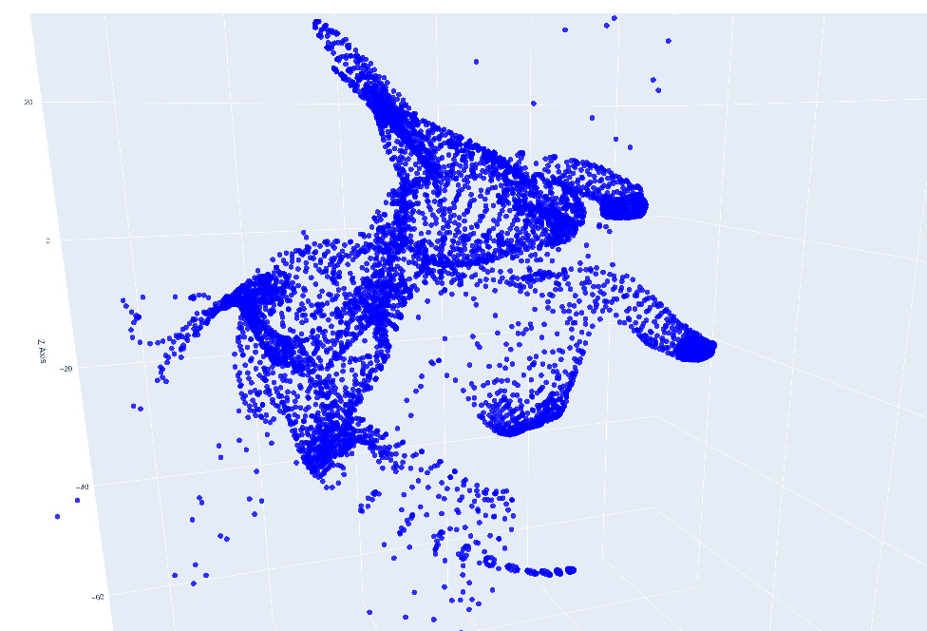

Slide 11
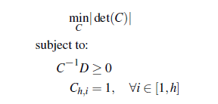
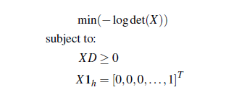




Finding Minimum Volume Enclosing Simplex
Initial Problem:
Transformed Problem:

Slide 12
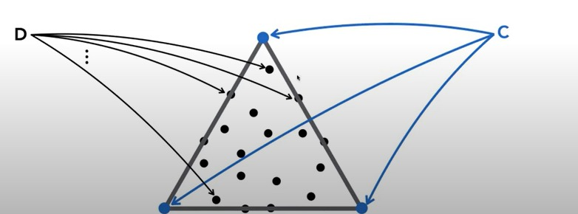

Slide 13
RESULTS:
The Rendered Images have a nice shape and structure. The Inverse SKinning was able to get the pose as intended in some cases if not, better with much finer detail.

Slide 14
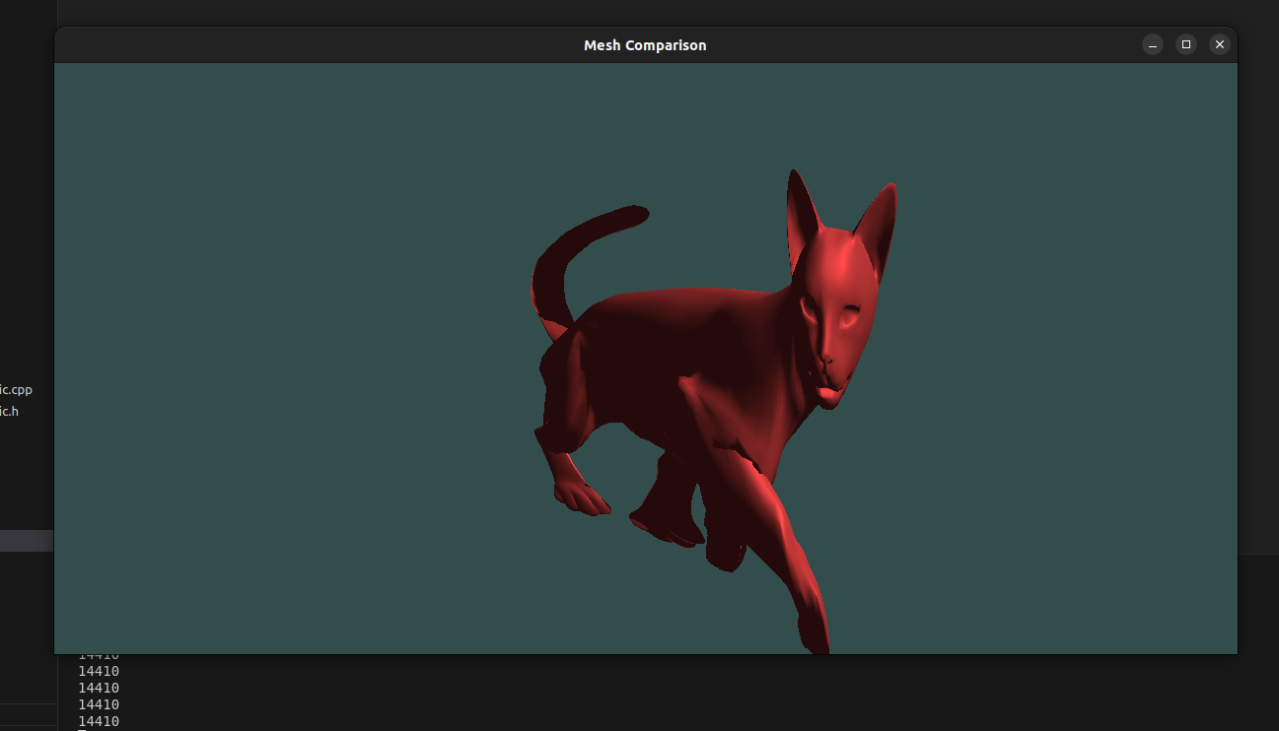

Slide 15
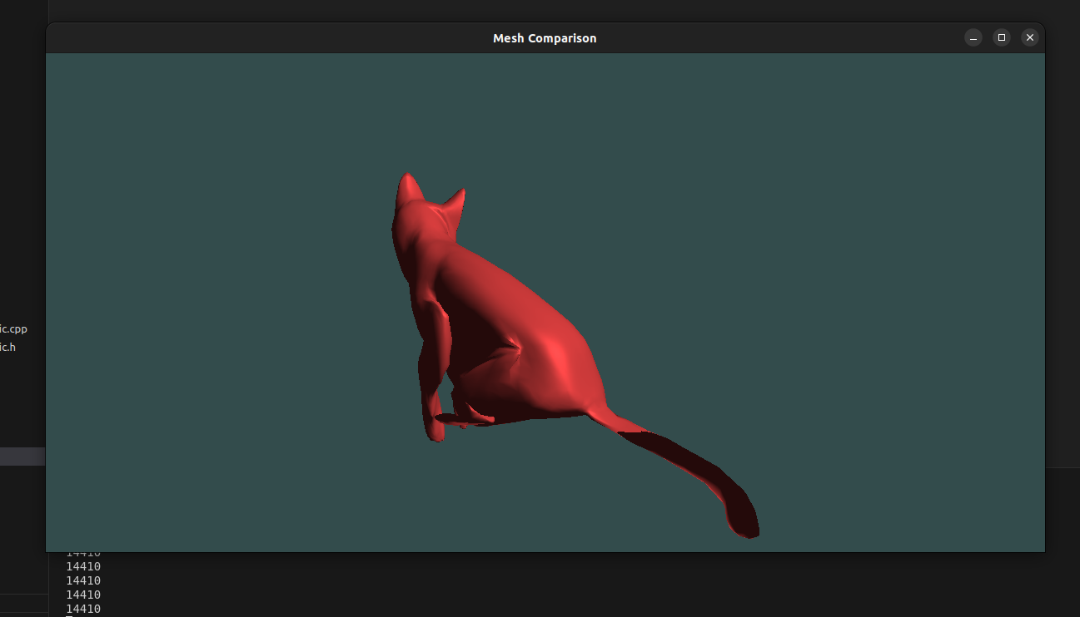

Slide 16
